Slide 1

MINI PROJECT 02
11 SEP 2021
Nadun Basnayake

Slide 2
Business Question
Load Default Prediction
Definition: Failure of Loan Payment
Can we improve the current lending criteria by analyzing historical loan data?

Slide 3

Background
Lending Club is a peer-to-peer fintech company based in the US.
Originally launched on Facebook as a “Social Networking Service” and matched users based on factors such as geographic location, educational and professional background, and connectedness within a given social network.
Enables borrowers to create personal loans.
Investors can search and browse the loan listings on LendingClub website and select loans that they want to invest in based on the information supplied about the borrower, amount of loan, loan grade, and loan purpose.
Small to Medium scale loans
Lending Club Load Data
https://www.kaggle.com/wordsforthewise/lending-club?select=accepted_2007_to_2018Q4.csv.gz

Slide 4
Importance of the Question
Loan Defaults cost LendingClub nearly USD $400 million annually despite having a strict acceptance criteria

Slide 5
Pipeline
Data
Acquisition + Business Question
Exploring & Cleaning
Delivery
Modelling
Tuning & Validate

Slide 6
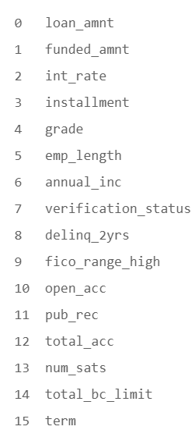
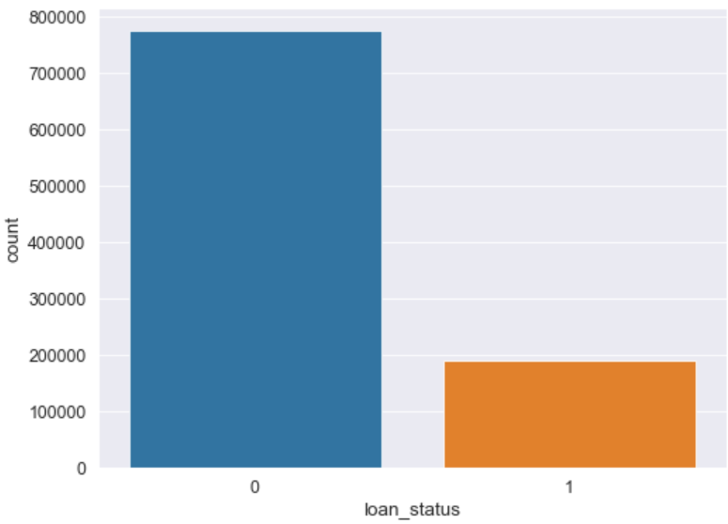
Dataset Summary
Excluded 130+ columns with loan history details & other leakage data
16 Feature Columns once cleaned
Excluded current loans
Target Variable: Loan Status
1: Default (Unpaid Loans)
0: Non-Default (Fully Paid Loans)
Ratio ~ 4:1

Slide 7
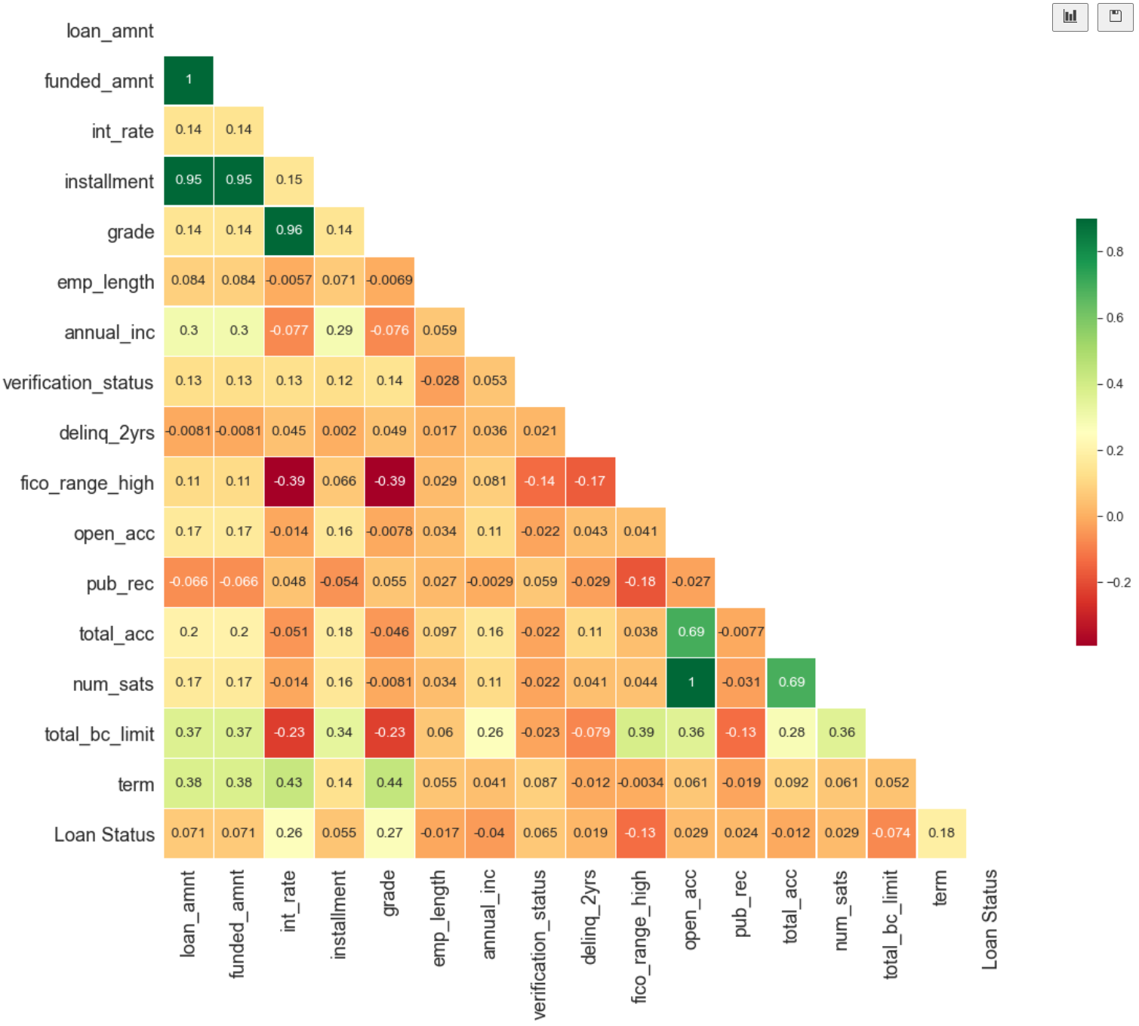
Correlation between variables

Slide 8
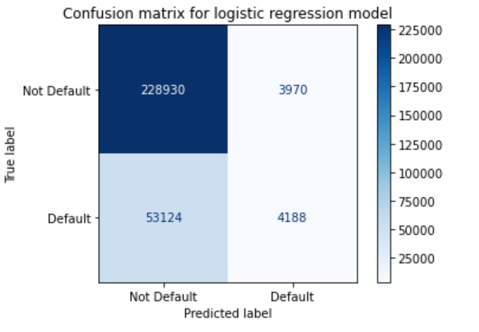
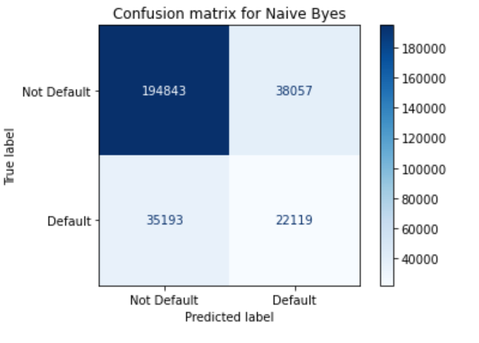
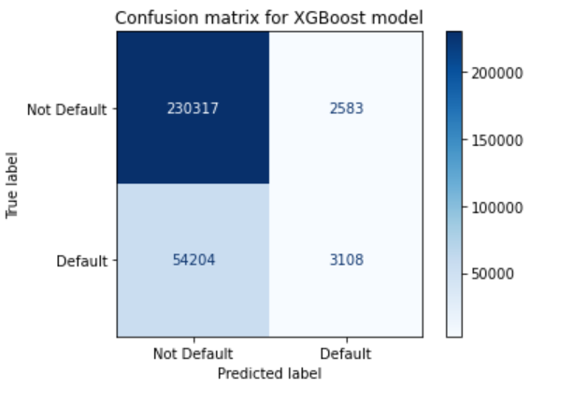
Preprocessing & Evaluation
Imbalanced Dataset
Logistic Regression
Naïve Bayes
XGBoost

Slide 9
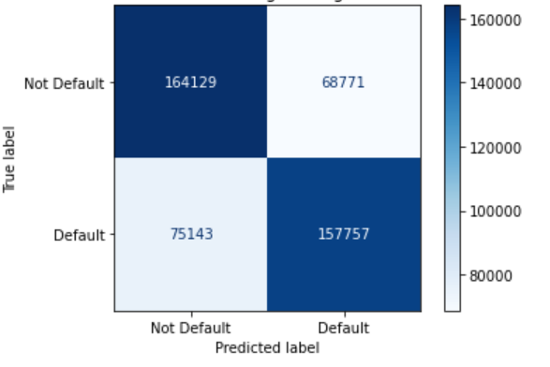
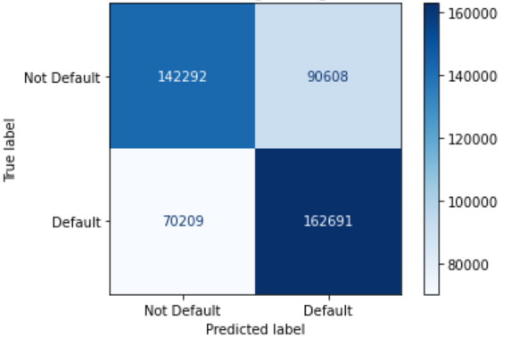
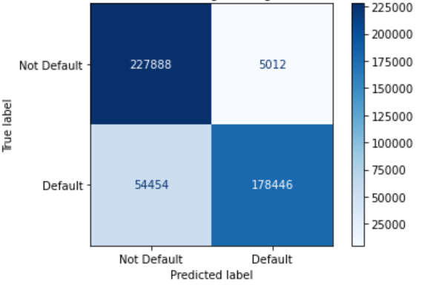
Oversampling - SMOTE
Logistic Regression
Naïve Bayes
XGBoost

Slide 10
Results on Oversampled Data
 | Accuracy | Recall | F1 Score
Logistic Regression | 0.69 | 0 = 0.70 1 = 0.68 | 0 = 0.70 1 = 0.69
Naive Bayes | 0.65 | 0 = 0.61 1 = 0.70 | 0 = 0.64 1 = 0.67
XGBoost | 0.87 | 0 = 0.98 1 = 0.77 | 0 = 0.88 1 = 0.86
0 = Non-Default (Fully Paid Loans)
1 = Defaults (Unpaid Loans)

Slide 11
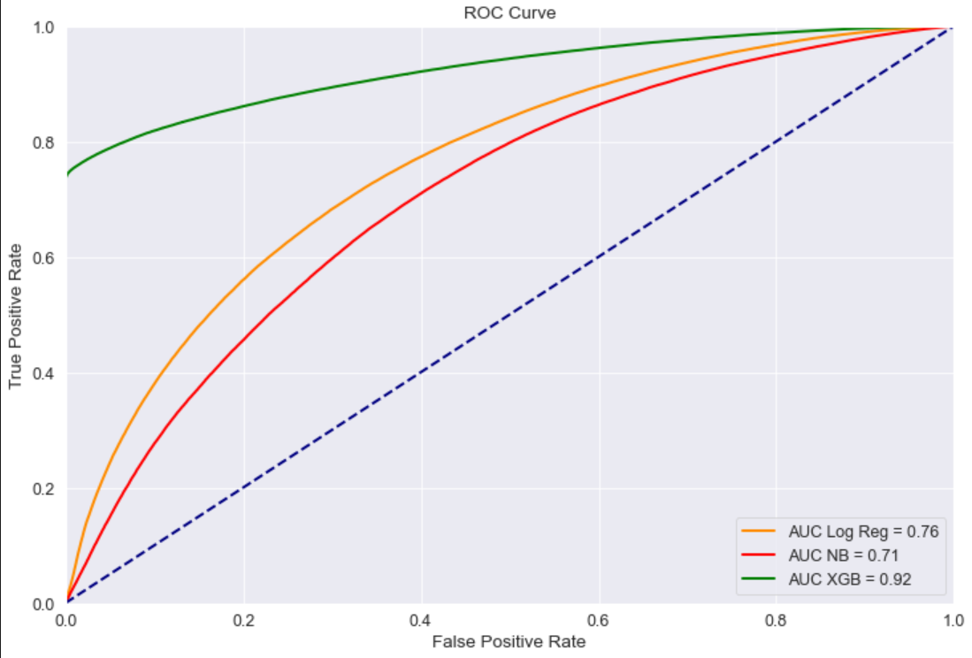
AUC-ROC
Overall XGB has the highest
predictive performance

Slide 12
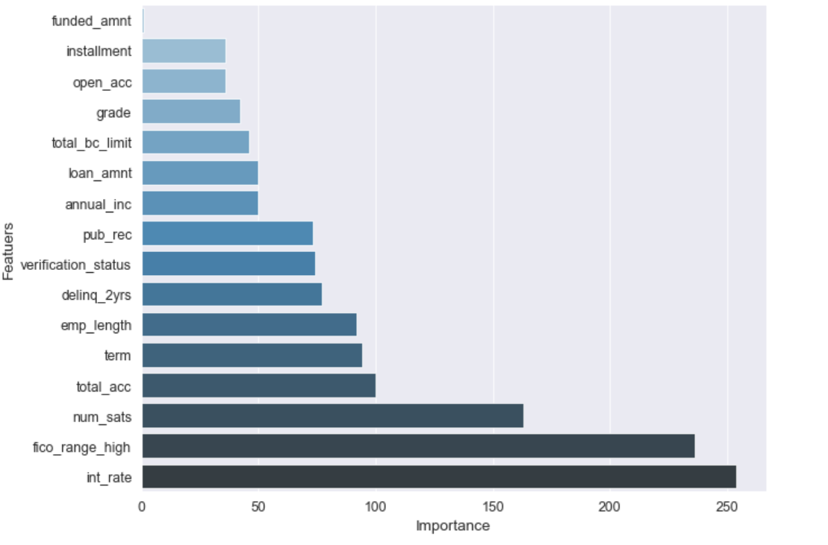
Feature Importance
Based on XGBoost feature importance score

Slide 13
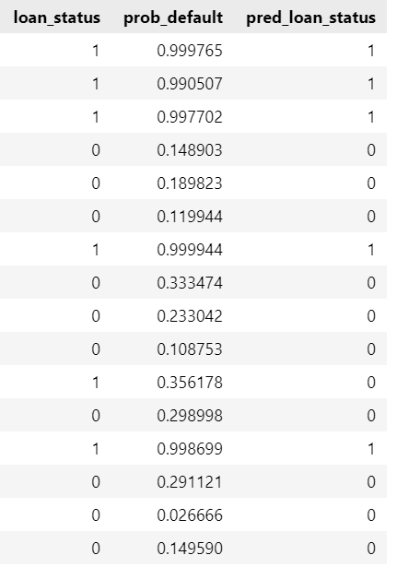
Actual vs Predicted
Bad Rate = Percentage of accepted loans that are Defaults
23.07%
The above value is subjected to company accepting rate & strategy (set to 80% for above calculation)

Slide 14
Model Recommendations & Improvements
Overall best model for a significant accuracy would be the XGBoost based model.
Include more text data columns based on domain knowledge and enhance the model (and perform One-Hot Encoding on them)
Dimensionality reduction (PCA) to reduce complexity

Slide 15
Thank You!

